Slide 1
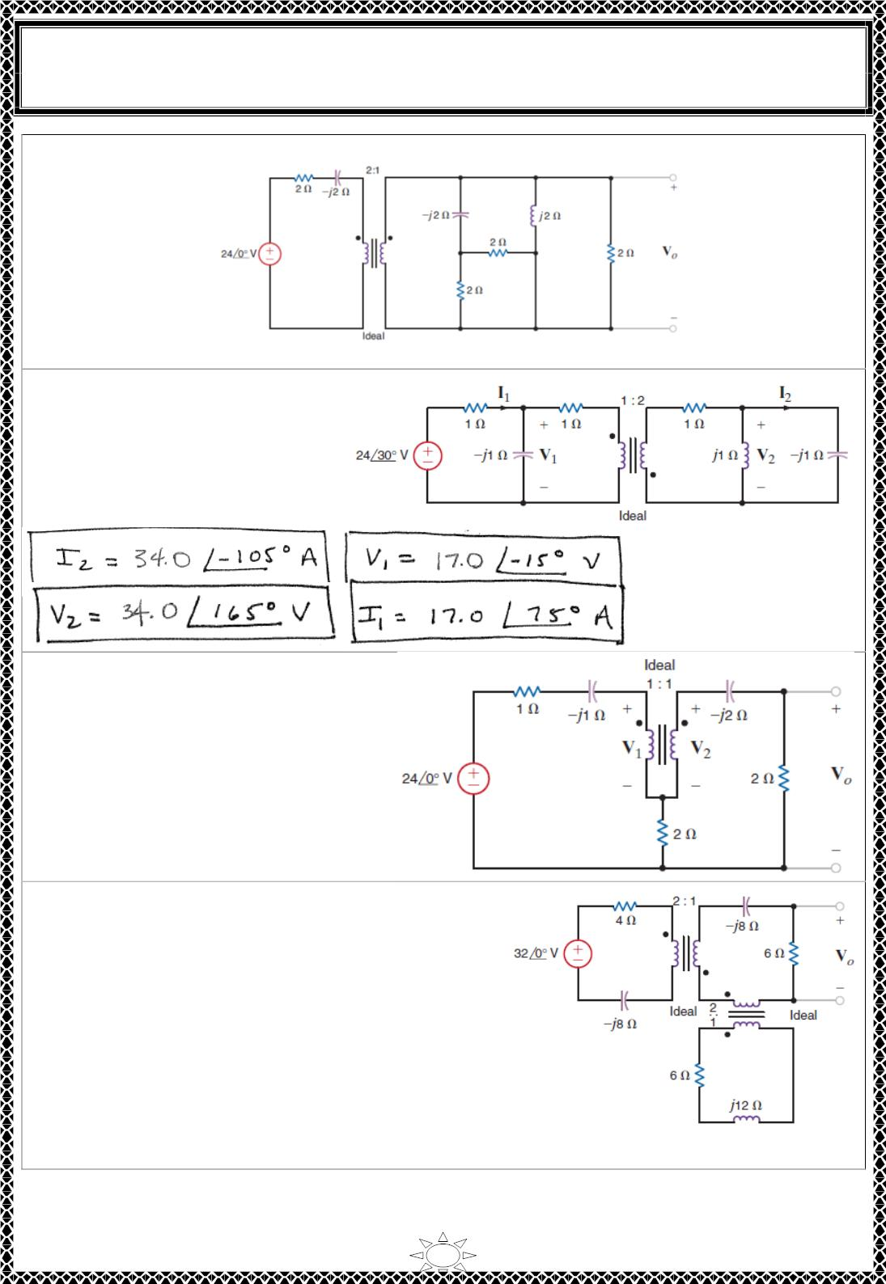
University of Diyala
Engineering College
Electronic Department
Electrical Circuits
2nd Class
Lecturer : Wisam N. AL-Obaidi
Year (2015-2016)
H.W.(40):Find V_{o} in the network in Fig. shown.
[Answer:]
H.W.(41): Determine I , I , V
1
2
1
and V₂in the network in Fig.
shown.
Trail Version
Trail Version
Trail Version
Trail Version
Trail Version
Trail Version
Trail Version
Trail Version
Trail Version
Trail Version
Trail Version
Trail Version
Trail Version
H.W.(42): Find V_{o} in the network in
Fig. shown.
[Answer:11.32∠45° ]
H.W.(43): Find V_{o} in the network in Fig. shown.
[Answer:1.96∠129° ]
8

Slide 2
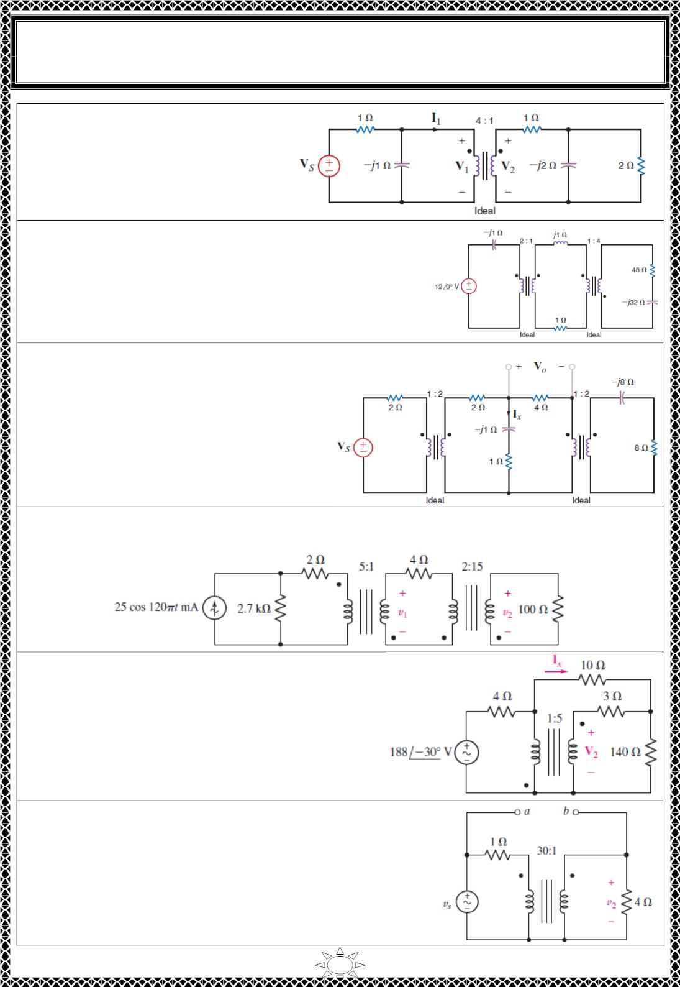
University of Diyala
Engineering College
Electronic Department
Electrical Circuits
2nd Class
Lecturer : Wisam N. AL-Obaidi
Year (2015-2016)
H.W.(44): Determine the input
impedance seen by the source in
Fig. shown.
[Answer:1.42∠- 43.9° ]
H.W.(45): Determine the input impedance seen by the
source in Fig. shown.
[Answer:]
H.W.(46):In the network in Fig. shown, if
I = 4∠30° find V .
x
0
[Answer: 3.58∠3.43° ]
Trail Version
Trail Version
Trail Version
Trail Version
Trail Version
Trail Version
Trail Version
Trail Version
Trail Version
Trail Version
Trail Version
Trail Version
Trail Version
H.W.(47): With respect to the circuit depicted in Fig. shown, calculate (a) the voltages v₁
and v₂; (b) the average power delivered to each resistor.
H.W.(48): Calculate I and V as labeled in Fig.
shown.
x
2
[Answer:]
H.W.(49): For the circuit of Fig. shown, v_{s}= 117 sin 500t
V. Calculate v₂ if the terminals marked a and b are (a)
left open-circuited; (b) short-circuited; (c) bridged by a 2
Ωresistor.
[Answer:]
9

Slide 3
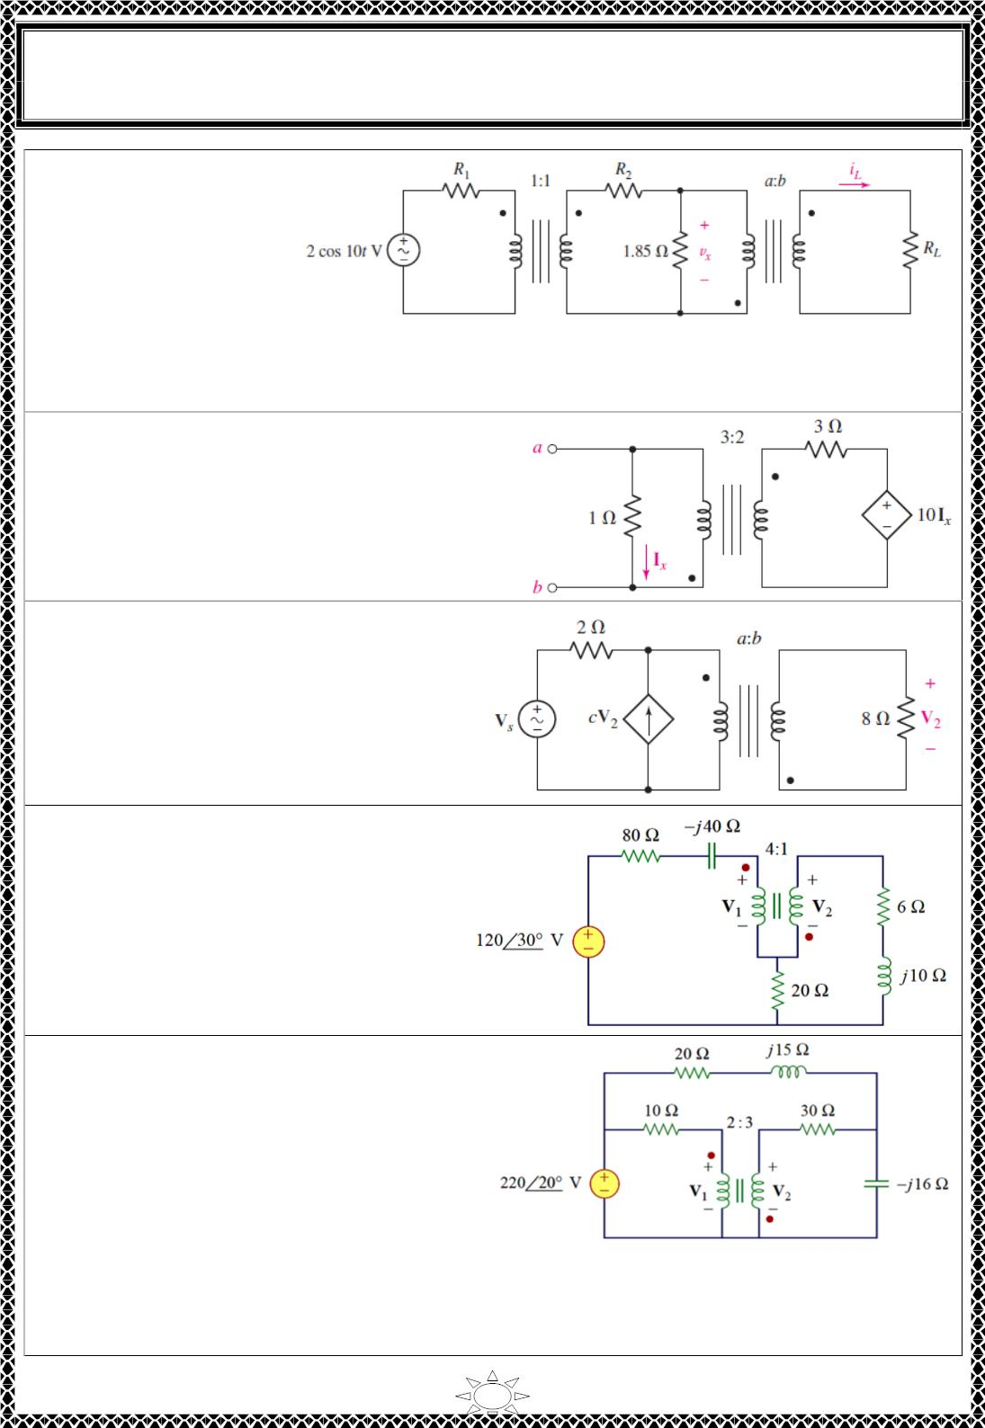
University of Diyala
Engineering College
Electronic Department
Electrical Circuits
2nd Class
Lecturer : Wisam N. AL-Obaidi
Year (2015-2016)
H.W.(50): For the
circuit of Fig. shown, R₁
= 1 Ω, R₂ = 4 Ω, and
R_{L}= 1 Ω. Select a andb
to achieve a peak
voltage of 200
magnitude across R_{L}.
[Answer:]
V
H.W.(51):
Determine
the
Thévenin
equivalent of the network in Fig. shown as
seen looking into terminals a and b.
[Answer:]
H.W.(52): For the circuit of Fig. , take c=
–2.5 mS and select values of a andb such
that 100W average power is delivered to
the 8Ωload when V_{s}= 5∠−35◦V.
Trail Version
Trail Version
Trail Version
Trail Version
Trail Version
Trail Version
Trail Version
Trail Version
Trail Version
Trail Version
Trail Version
Trail Version
Trail Version
[Answer:]
H.W.(53): find V &V in the ideal
1
2
transformer circuit of Fig.
[Answer:
ퟗퟏ. ퟏퟐ∠ퟑퟕ. ퟗퟐ^{퐨} 퐕, ퟐퟐ. ퟕퟖ∠−ퟏퟒퟐ. ퟏ^{퐨} 퐕]
H.W.(54): find V₁&V₂ in the ideal
transformer circuit of Fig.
[Answer:ퟏퟑퟖ. ퟖퟐ∠ퟐퟖ. ퟔퟓ^{퐨 퐕, ퟐퟎퟖ. ퟐ∠−ퟏퟓퟏ. ퟒ퐨 퐕}
]
10

Slide 4
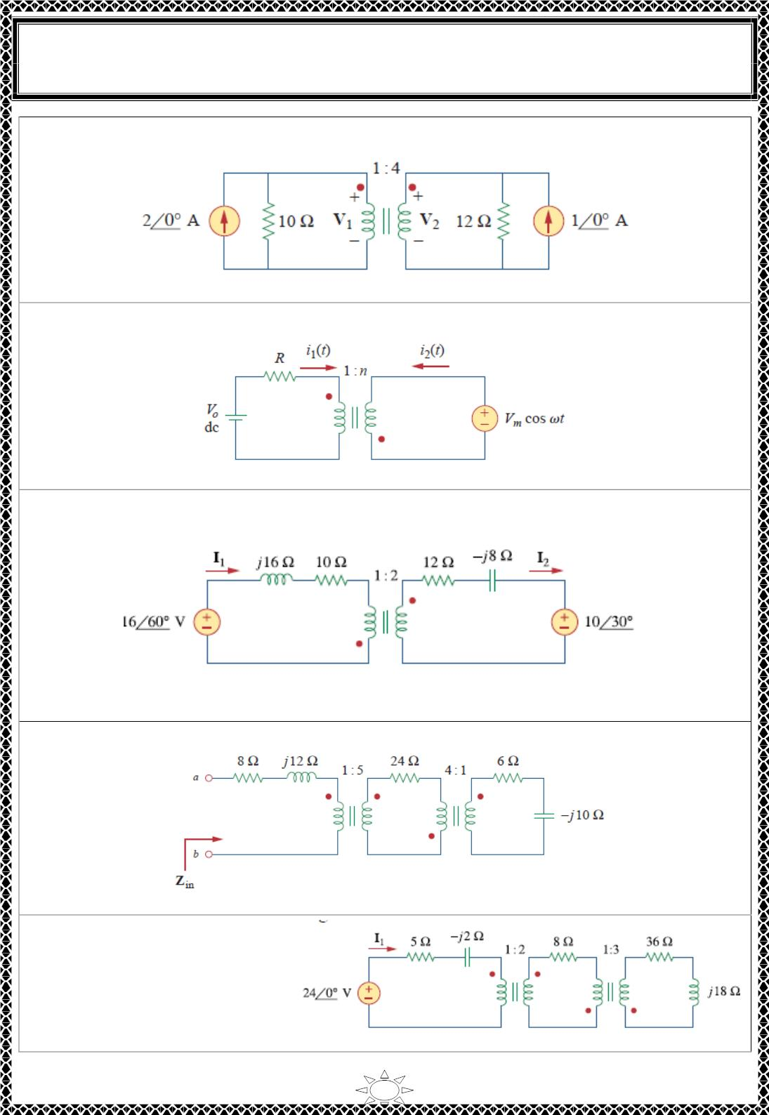
University of Diyala
Engineering College
Electronic Department
Electrical Circuits
2nd Class
Lecturer : Wisam N. AL-Obaidi
Year (2015-2016)
H.W.(55): Obtain V and V in the ideal transformer circuit of Fig.
1
2
[Answer:v = 4.186 V and v = 4v = 16.744 V]
1
2
H.W.(56): In the ideal transformer circuit of Fig., find i (t) and i (t).
1
2
2
[Answer:i (t) = (v /Rn)cosωt A, and i (t) = (–v /(n R))cosωt A]
1
m
2
m
H.W.(57): Find I and I in the circuit of Fig. below. (b) Switch the dot on one of the
1
2
Trail Version
Trail Version
Trail Version
Trail Version
Trail Version
Trail Version
Trail Version
Trail Version
Trail Version
Trail Version
Trail Version
Trail Version
Trail Version
windings. Find I and I again.
1
2
[Answer (a) I = 1.072∠5.88°A, and I = 0.536∠185.88°A (b) I = 0.625 ∠25 A, and I =
1
2
1
2
0.3125∠25°A]
H.W.(58): Calculate the input impedance for the network in Fig.
[Answer:Z_{in} = (12.8 + j5.6) ohms]
H.W.(59): Use the concept of
reflected impedance to find the
input impedance and current I₁
in Fig.
[Answer:I₁ = 8.95∠10.62°A]
11

Slide 5
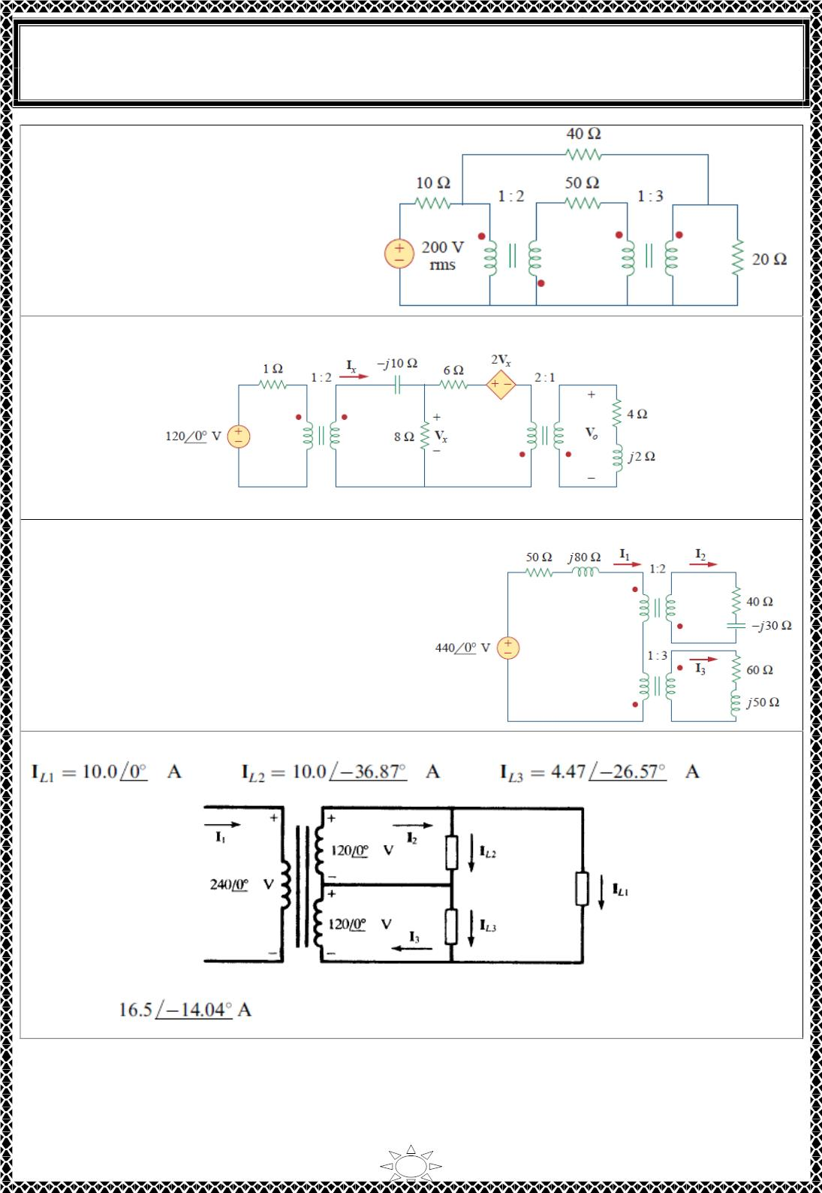
University of Diyala
Engineering College
Electronic Department
Electrical Circuits
2nd Class
Lecturer : Wisam N. AL-Obaidi
Year (2015-2016)
H.W.(60): Calculate the average
power dissipated by the 20- Ωresistor
in Fig.
[Answer: 11.05 W]
H.W.(61): Find I and V in the circuit of Fig.
x
x
[Answer: iX = 1.08∠33.91° A, Vx = 15.14∠–34.21° V.]
H.W.(62): Determine I , I , and I in the ideal
1
2
3
Trail Version
Trail Version
Trail Version
Trail Version
Trail Version
Trail Version
Trail Version
Trail Version
Trail Version
Trail Version
Trail Version
Trail Version
Trail Version
transformer circuit of Fig.
[Answer: I = 4.028∠–52.38° A, I = 2.019∠–
1
2
52.11° A, I₃ = 1.338∠–52.2° A.]
H.W.(63): For the ideal transformer shown in Fig, find I₁, given
[Answer:
]
12

Slide 6
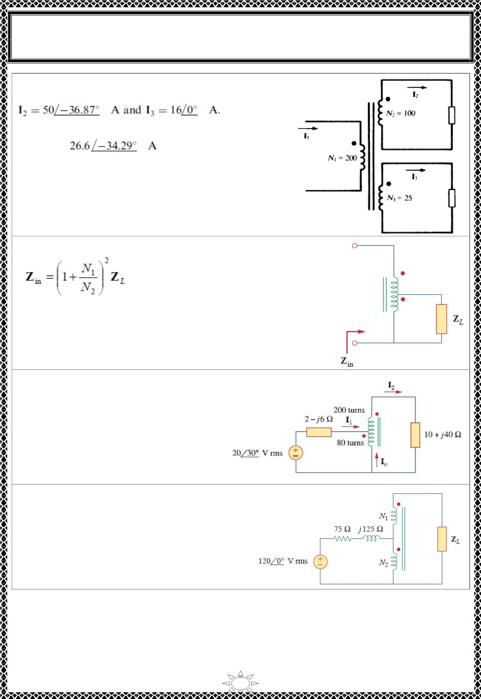
University of Diyala
Engineering College
Electronic Department
Electrical Circuits
2nd Class
Lecturer : Wisam N. AL-Obaidi
Year (2015-2016)
H.W.(64): For the ideal transformer shown in Fig.,
find I₁, given
[Answer:
]
H.W.(65): In the autotransformer circuit in Fig., show that
Trail Version
Trail Version
Trail Version
Trail Version
Trail Version
Trail Version
Trail Version
Trail Version
Trail Version
Trail Version
Trail Version
Trail Version
Trail Version
[Answer:]
H.W.(66): In the ideal autotransformer
of Fig., calculate I , I , and I Find the
1
2
o
average power delivered to the load.
[Answer:
I₁ = 1.245∠–33.76°A,
I₂ = 0.8893∠–33.76°A,
I_{o} = 0.3557∠146.2°A,
p = 7.51 watts]
H.W.(67): In the circuit of Fig., Z_{L} is adjusted
until maximum average power is delivered to
Z Find Z and the maximum average power
L.
L
transferred to it. Take N = 600 turns and N =
200 turns.
1
2
[Answer: Z_{L} = (1.2 – j2) kΩ, p= 5.333 w]
13

Slide 7
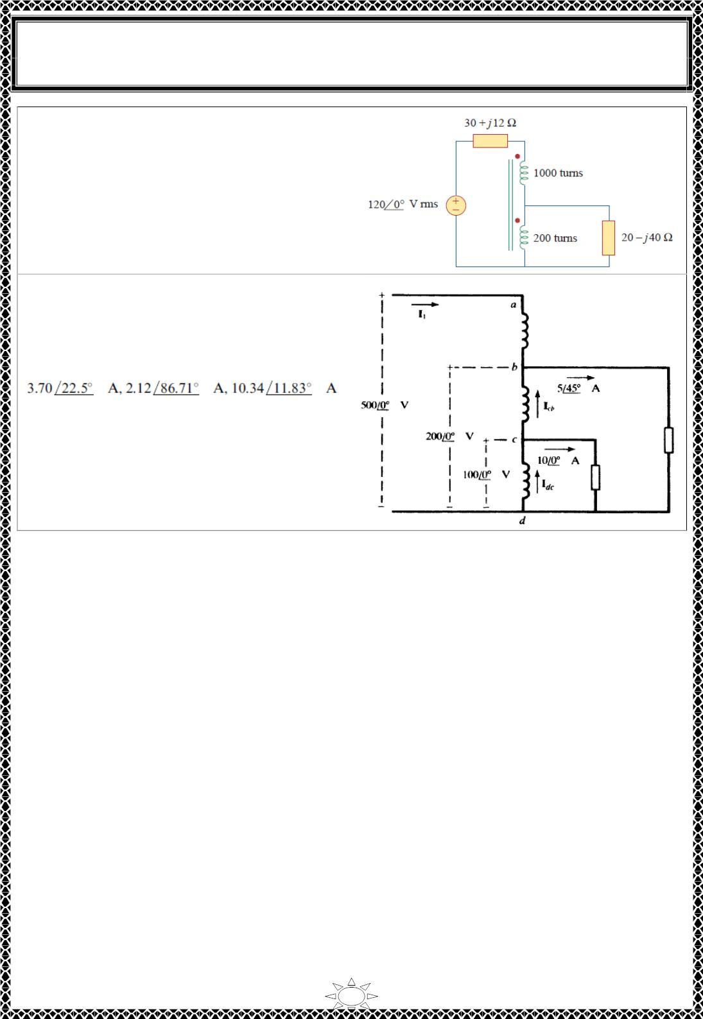
University of Diyala
Engineering College
Electronic Department
Electrical Circuits
2nd Class
Lecturer : Wisam N. AL-Obaidi
Year (2015-2016)
H.W.(68): In the ideal transformer circuit
shown in Fig., determine the average power
delivered to the load.
[Answer: 74.9 watts.]
H.W.(69): Considering the autotransformer
shown in Fig. ideal, obtain the currents I₁,
I , and I .
cb
dc
[Answer:]
Trail Version
Trail Version
Trail Version
Trail Version
Trail Version
Trail Version
Trail Version
Trail Version
Trail Version
Trail Version
Trail Version
Trail Version
Trail Version
14

Slide 8
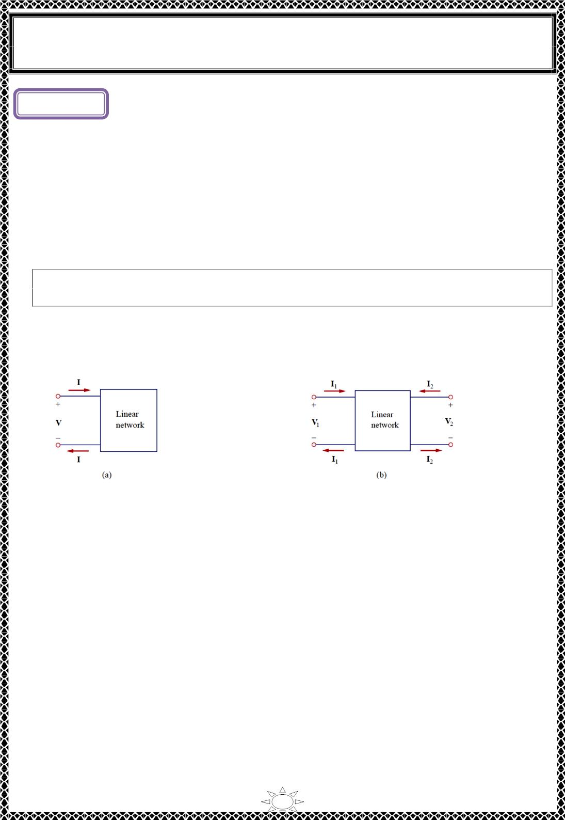
University of Diyala
Engineering College
Electronic Department
Electrical Circuits
2nd Class
Lecturer : Wisam N. AL-Obaidi
Year (2015-2016)
Lecture ( 1 )
Two-Port Networks
1) Introduction
• A port is a pair of terminals through which a current may enter or leave a network.
• A one-port network is a two-terminal networks or devices or elements (such as
resistors, capacitors, and inductors). Most of the circuits we have dealt with so far
are two-terminal or one-port circuits as in Fig.1.1 (a).
• A Two-port network is a four terminals networks or devices or elements(as shown in
Fig.1.1 (b)), such as op amps, transistors, and transformers.
• A two-port network is an electrical network with two separate ports for input
and output.
• A multi-ports network is an n-ports (n-pairs of terminals) networks or devices or
elements.
Note: the current entering one terminal leaves through the other terminal so that the net
current entering the port equals zero.
Trail Version
Trail Version
Trail Version
Trail Version
Trail Version
Trail Version
Trail Version
Trail Version
Trail Version
Trail Version
Trail Version
Trail Version
Trail Version
Fig.1.1 (a) One-port network, (b) two-port network.
Importance of two-port networks
1) Such networks are useful in communications, control systems, power systems, and
electronics. For example, they are used in electronics to model transistors and to
facilitate cascaded design.
2) Knowing the parameters of a two-port network enables us to treat it as a “black
box” when embedded within a larger network.
To characterize a two-port network requires that we relate the terminal quantities V , V ,
1
2
I , and I in Fig.1.1 (b), out of which two are independent. The various terms that relate
1
2
these voltages and currents are called parameters. There are six sets of these parameters:
1) Impedance Parameters (z-parameters)
2) Admittance Parameters (y-parameters)
3) Hybrid Parameters (h-parameters)
4) Inverse Hybrid Parameters (g-parameters)
5) Transmission Parameters (ABCD or T parameters)
6) Inverse Transmission Parameters (abcd or t parameters)
1

Slide 9
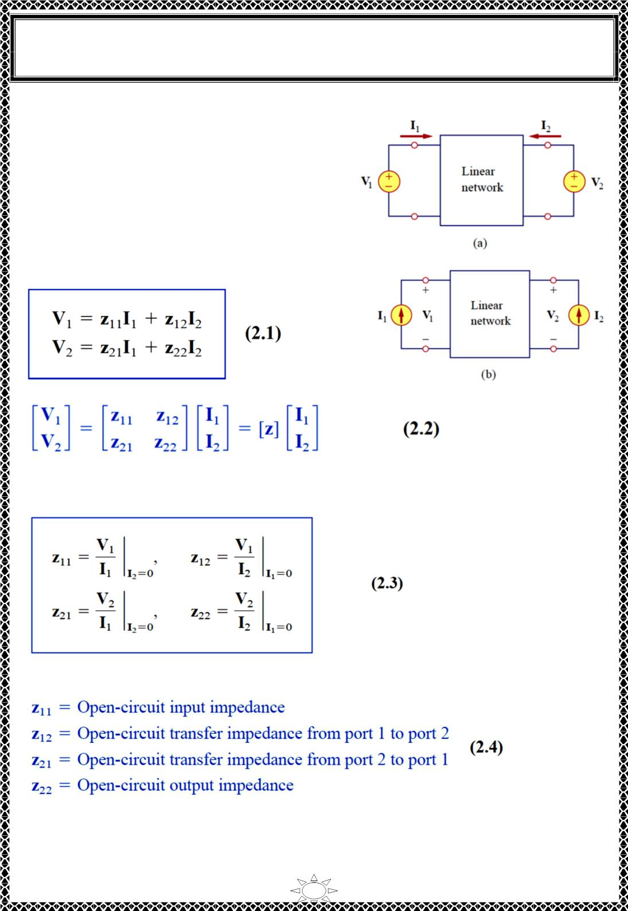
University of Diyala
Engineering College
Electronic Department
Electrical Circuits
2nd Class
Lecturer : Wisam N. AL-Obaidi
Year (2015-2016)
1) Impedance Parameters (z-parameters)
Impedance and admittance parameters are
commonly used in the synthesis of filters. They
are also useful in the design and analysis of
impedance-matching networks and power
distribution networks.
A two-port network may be voltage-driven as in
Fig.2.1 (a) or current-driven as in Fig.2.1 (b).
From either Fig.2.1 (a) or (b), the terminal
voltages can be related to the terminal currents as
Fig.2.1
Trail Version
Trail Version
Trail Version
Trail Version
Trail Version
Trail Version
Trail Version
Trail Version
Trail Version
Trail Version
Trail Version
Trail Version
Trail Version
where the z terms are called impedance parameters, or z parameters, and have units of ohms.
The values of the parameters can be evaluated by setting I1 = 0 (input port open-circuited)
or I2 = 0 (output port open-circuited) as shown in Fig.2.2. Thus,
Since the z parameters are obtained by open-circuiting the input or output port, they are
also called the open-circuit impedance parameters. Specifically,
Sometimes z and z are called driving-point impedances, while z and z are called transfer
11
22
12
21
impedances. When z = z , the two-port network is said to be symmetrical.
11
22
2

Slide 10
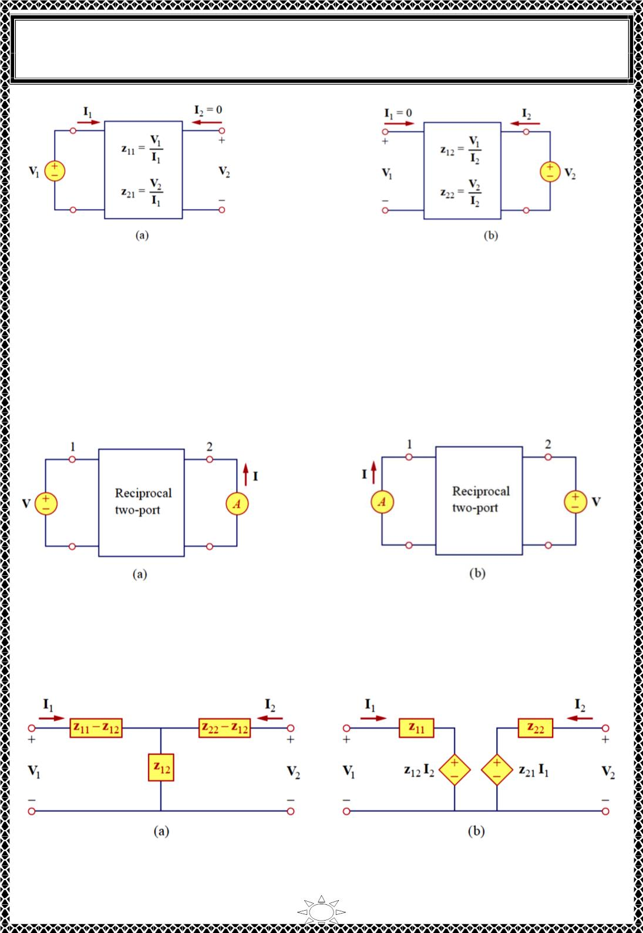
University of Diyala
Engineering College
Electronic Department
Electrical Circuits
2nd Class
Lecturer : Wisam N. AL-Obaidi
Year (2015-2016)
Fig.2.2. Determination of the z parameters
1.1) Reciprocal networks
When the two-port network is linear and has no dependent sources, the transfer
impedances are equal (z = z ), and the two-port is said to be reciprocal. This means that if
12
21
the points of excitation and response are interchanged, the transfer impedances remain the
same. As illustrated in Fig.2.3, a two-port is reciprocal if interchanging an ideal voltage
source at one port with an ideal ammeter at the other port gives the same ammeter reading.
The reciprocal network yields 퐕 = 퐳 퐈 when connected as in Fig.2.3 (a), but yields 퐕 =
ퟏퟐ
퐳 퐈 when connected as in Fig.2.3 (b). This is possible only if 퐳 = 퐳 .
Trail Version
Trail Version
Trail Version
Trail Version
Trail Version
Trail Version
Trail Version
Trail Version
Trail Version
Trail Version
Trail Version
Trail Version
ퟐퟏ
Trail Version
ퟏퟐ
ퟐퟏ
Fig.2.3
Any two-port that is made entirely of resistors, capacitors, and inductors must be
reciprocal. A reciprocal network can be replaced by the T-equivalent circuit in Fig.
Fig.2.4(a). If the network is not reciprocal, a more general equivalent network is shown in
Fig.2.4(b); notice that this figure follows directly from Eq. (2.1).
Fig.2.4 (a) T-equivalent circuit (for reciprocal case only), (b) general equivalent circuit.
3

